Slide 1
TERM PROJECT GROUP 4
Jesus CortezBonilla
Kevin De LA Torre
Joshua Rowill Koa
Bryan Mendoza
Samuel Mendoza

Slide 2
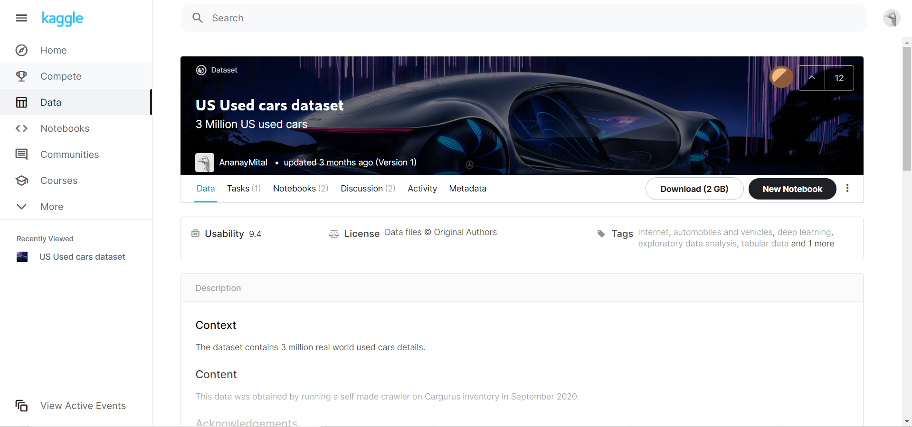
Dataset Location
https://www.kaggle.com/ananaymital/us-used-cars-dataset
FILE SIZE
COMPRESSED: 2 GB
UNCOMPRESSED: 9.29GB

Slide 3



Oracle big data service
EMR CLUSTER: 3 NODES
VERSION: 20.3.3-20
12 OCPUs
Memory: 180GB
Storage: 957GB
Applications: Hive, Pig, Tez, Sqoop, HCatalog, Tableau

Slide 4
Flowchart for data analysis
Downloaded Data From:
https://www.kaggle.com/ananaymital/us-used-cars-dataset
Upload file using WINSCP
Uncompressed zip file
Created Hive tables based on CSV file
Move Data into Hadoop Distribution File System
Output Results and various csv files
Copied various csv files on to Desktop
Created visualizations based on csv files in Tableau/SAP Analytic Cloud

Slide 5
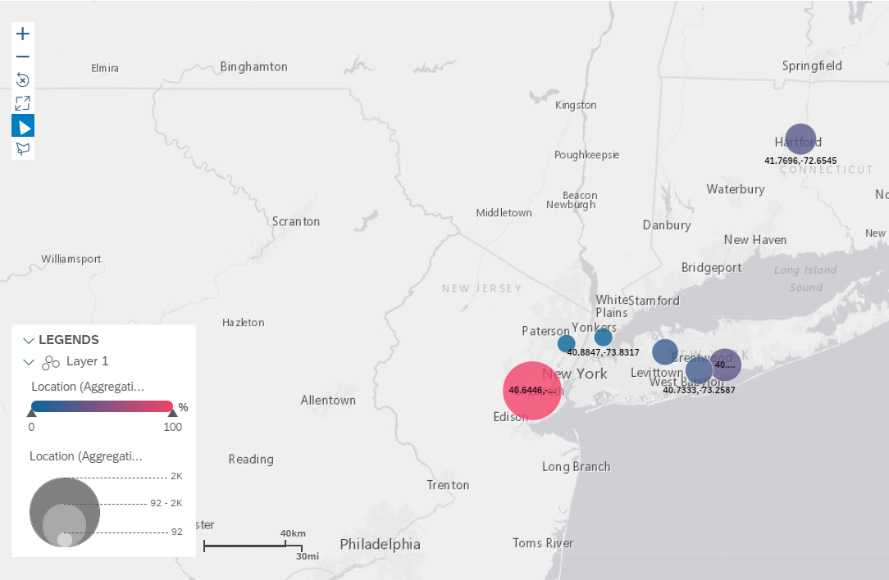
Geo Spatial Visualization
AVERAGE DAYS ON MARKET
LINDEN: 297.93
BOHEMIA: 166.98
HARTFORD 158.48
WOODBURY 132.57
BAYSHORE: 140
BRONX: 92.60
LITTLE FERRY: 91.72

Slide 6
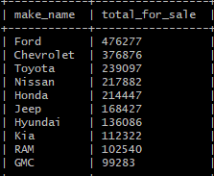
Top 10 Car Brands Being Sold
10 rows, 270.319 seconds = 4 mins 50 seconds

Slide 7
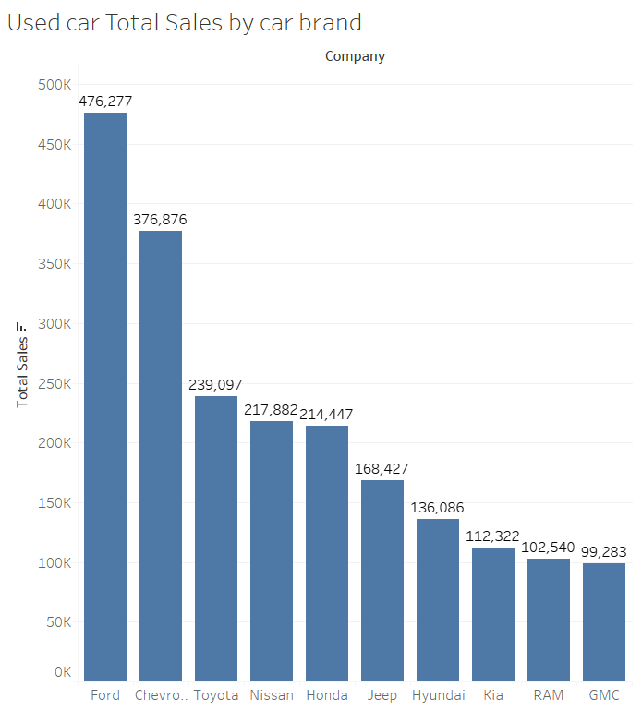
Top 10 Car Brands for Sale
Most for Sale are Ford followed by Chevy
Toyota, Nissan & Honda all follow one another closely
More RAMs for sale rather than Dodge

Slide 8
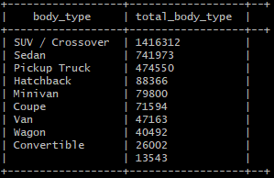
Types of Cars for Sold
10 rows, 252.162 seconds = 4 mins 20 seconds

Slide 9
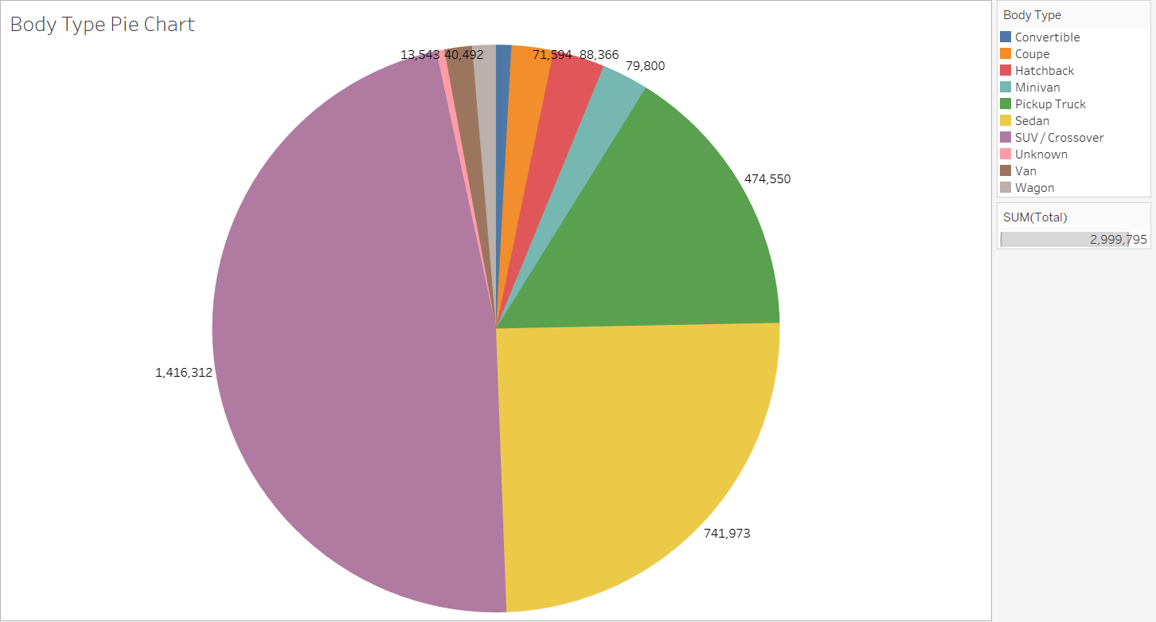
Types/Body Types being Sold

Slide 10
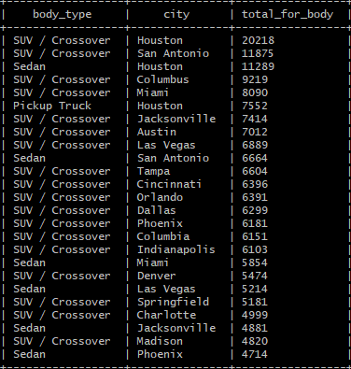
Top Car Type for Sale in 25 Cities
25 rows, 280 seconds = 4 min and 66 seconds

Slide 11
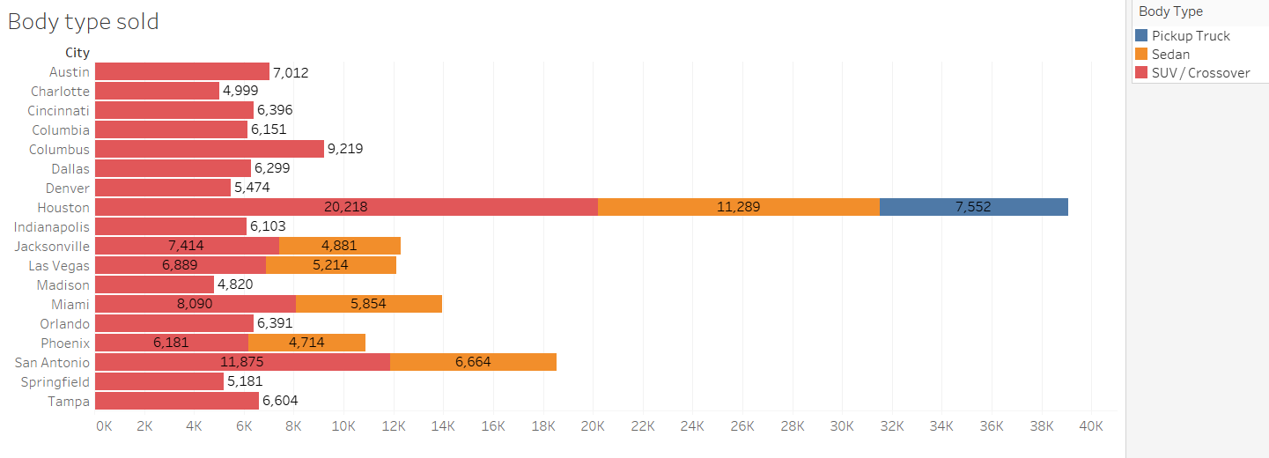

Slide 12
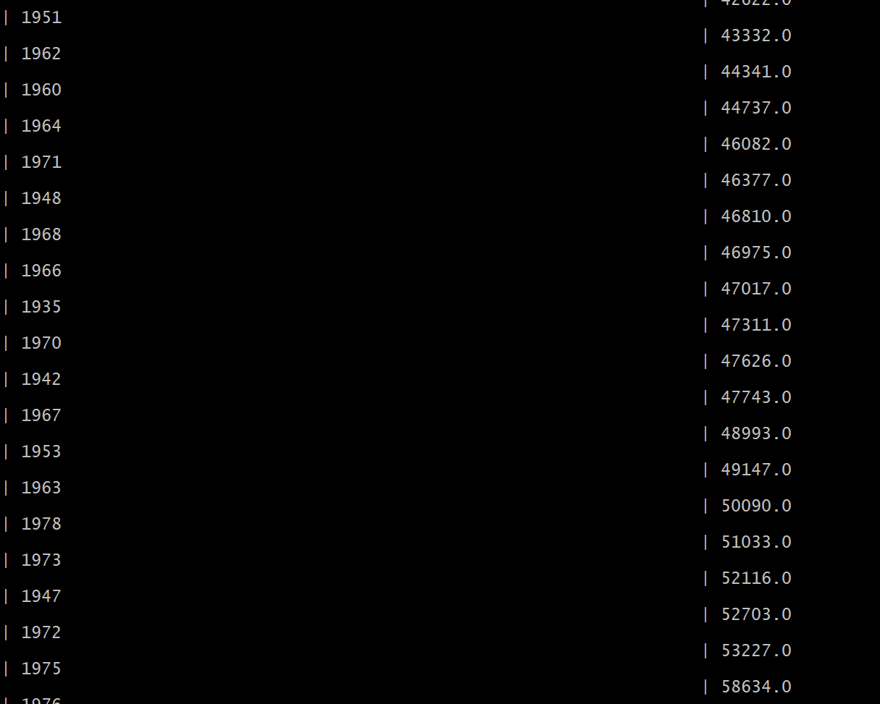
AVERAGE MILEAGE OF CARs BY YEAR
106 rows selected (287.12 seconds)

Slide 13
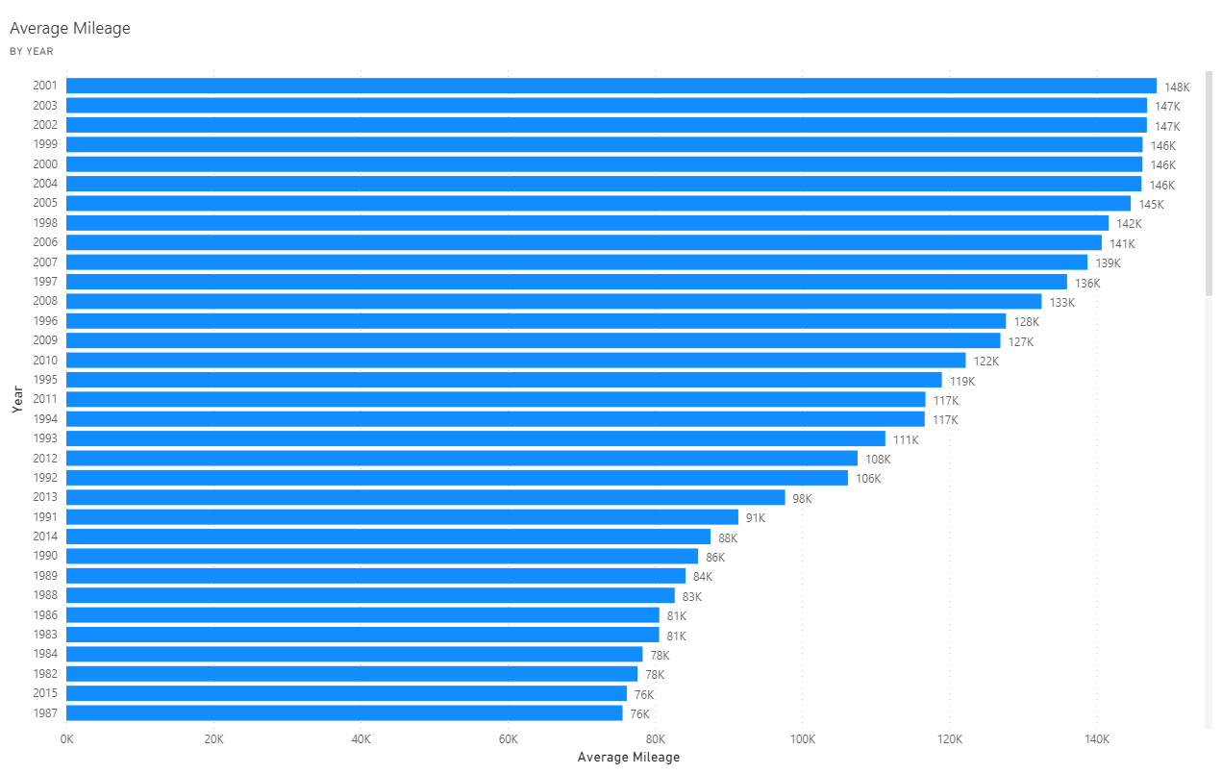
AVERAGE MILEAGE BY YEAR (CONT.)

Slide 14
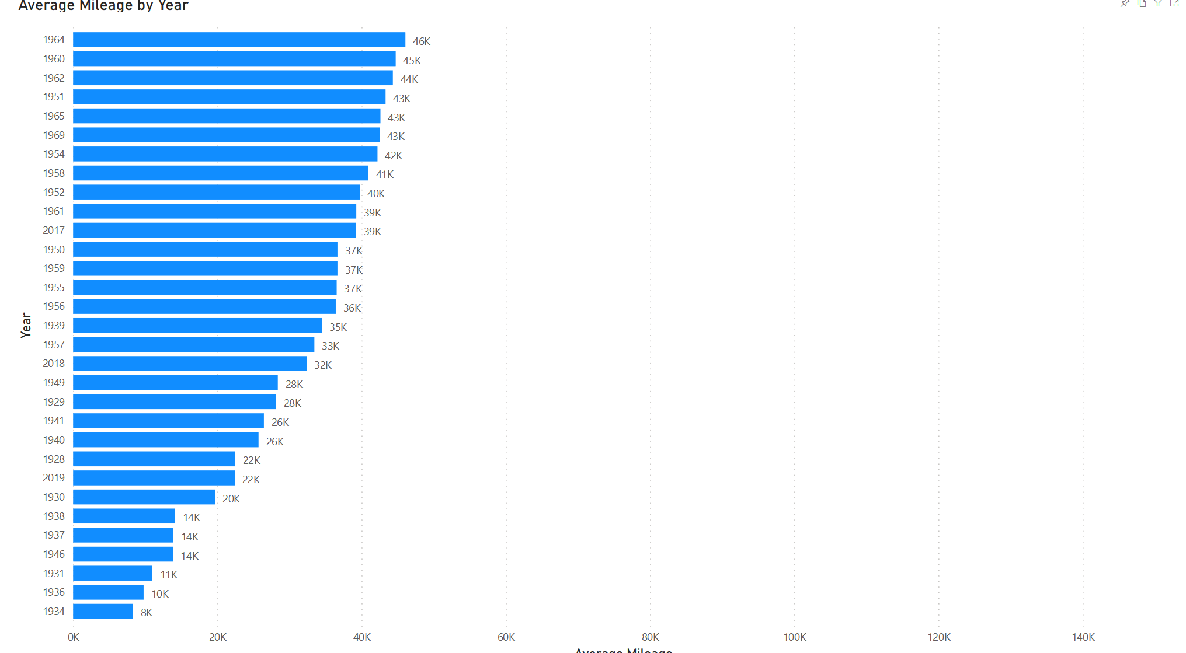
Average Mileage BY year

Slide 15
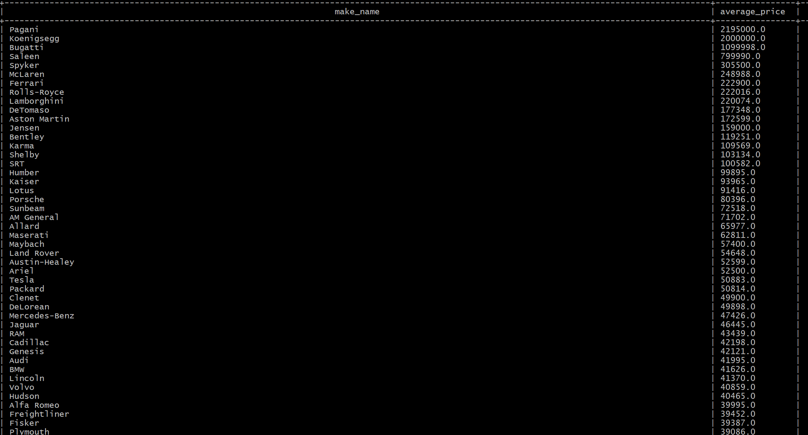
Average PRICE BY MAKE
110 rows selected (277.517 seconds)

Slide 16
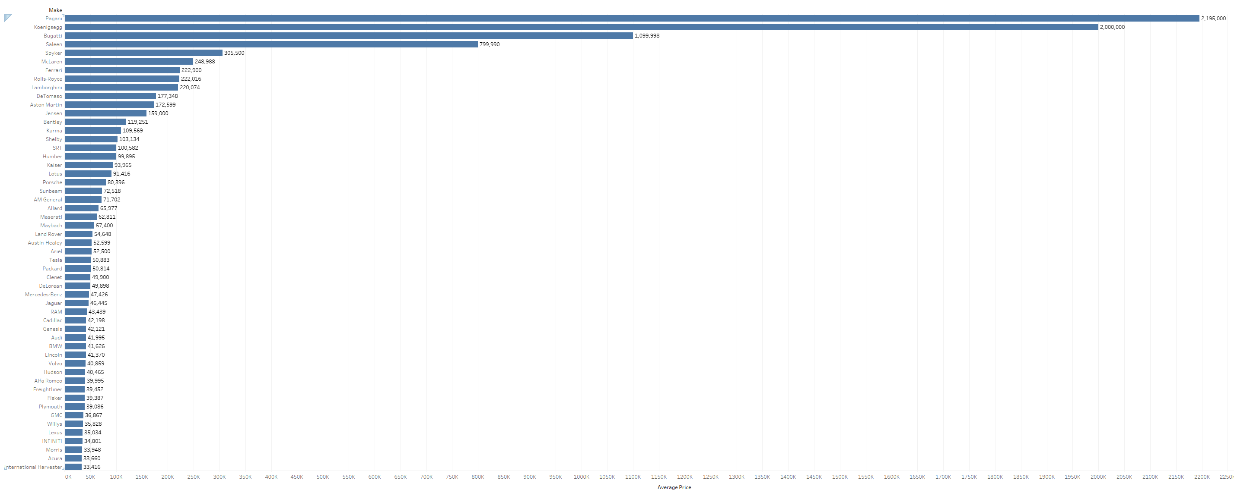
AVerage PRICE BY MAKE CONT.

Slide 17
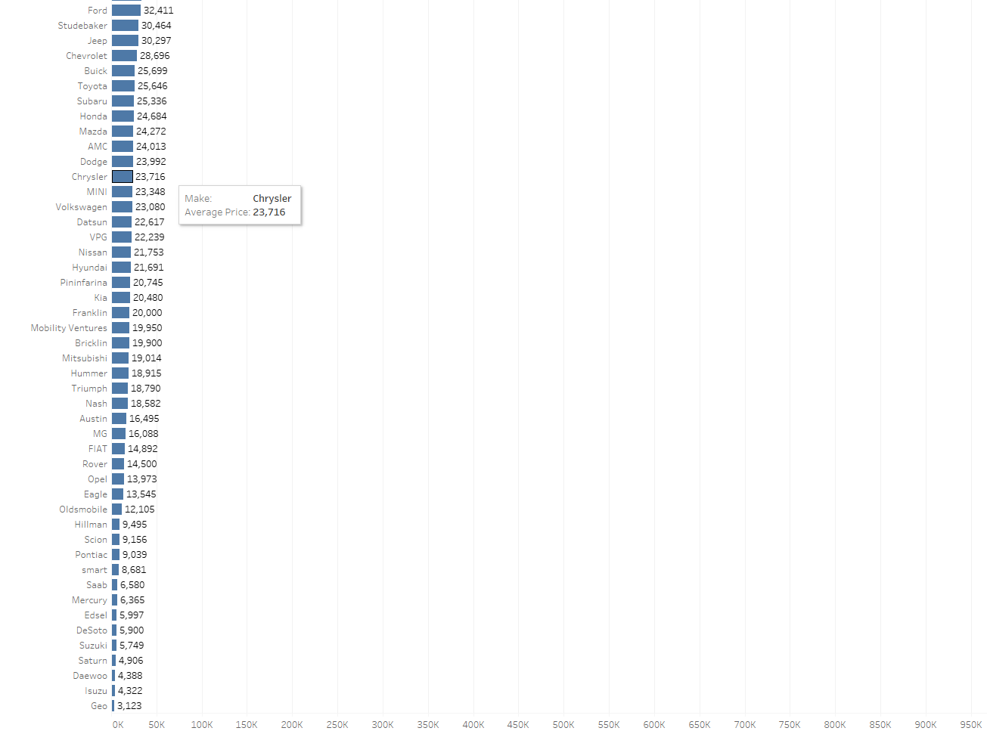
AVerage PRICE BY MAKE CONT.

Slide 18
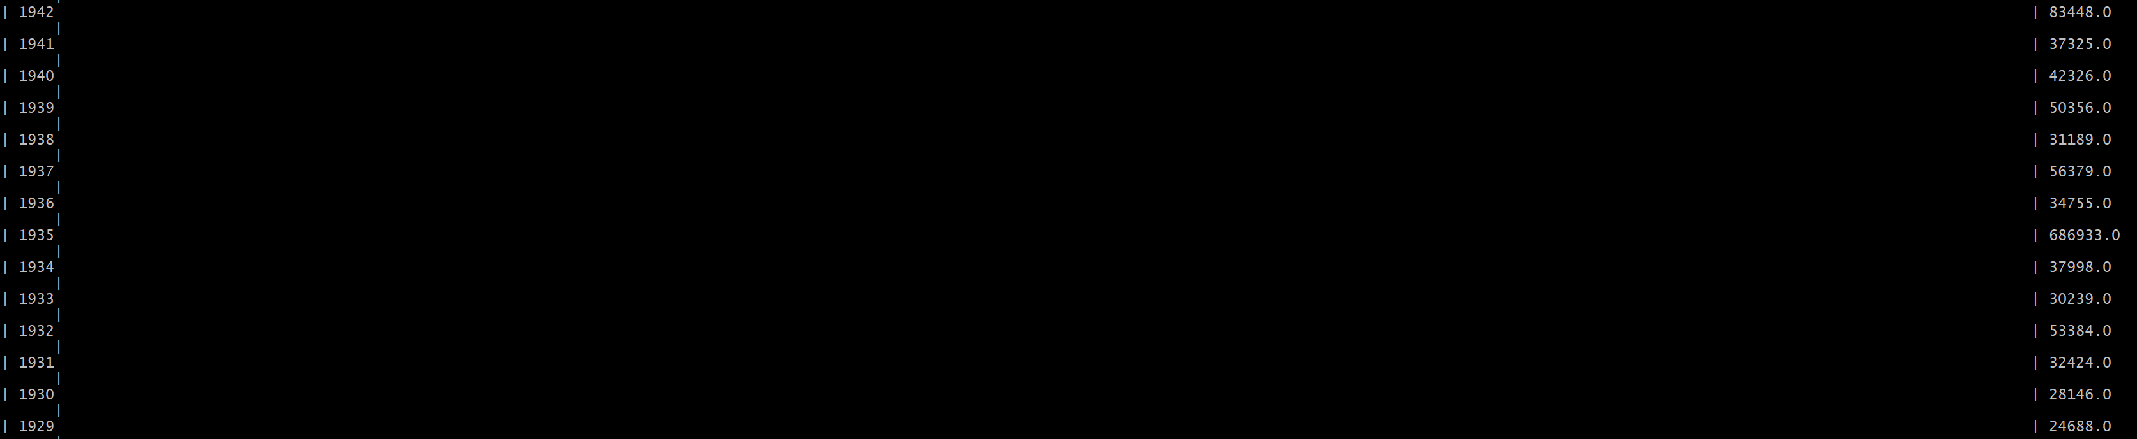
AVG PRICE BY YEAR
106 rows selected (256.639 seconds)

Slide 19
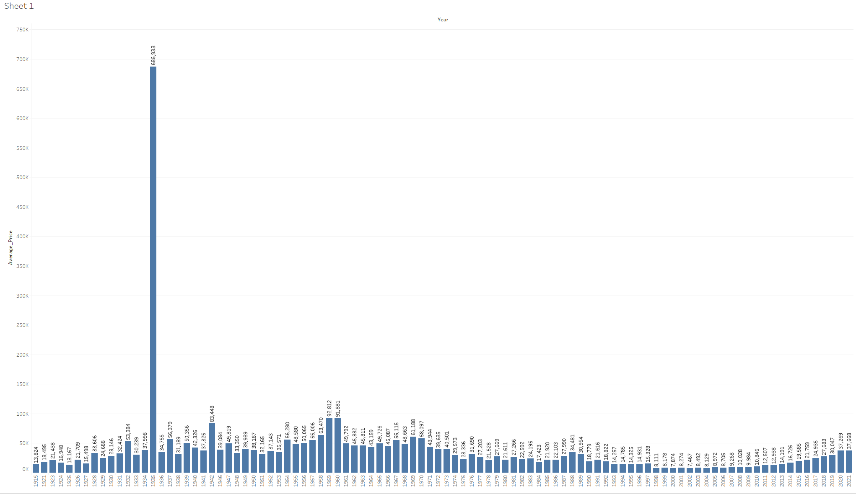

Slide 20
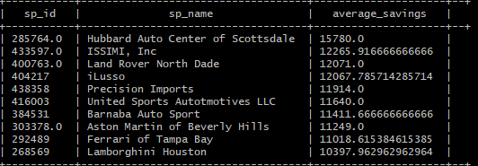
Average Savings Per Seller
SELECT sp_id, sp_name, AVG(savings_amount) AS Average_Savings FROM usedcartestfinal
GROUP BY sp_id, sp_name
ORDER BY Average_Savings
LIMIT 1000;
Total Rows: 1,000 selected
Query Size: 40 KB
Time Taken: ~ 5 minutes (287.584 seconds)

Slide 21
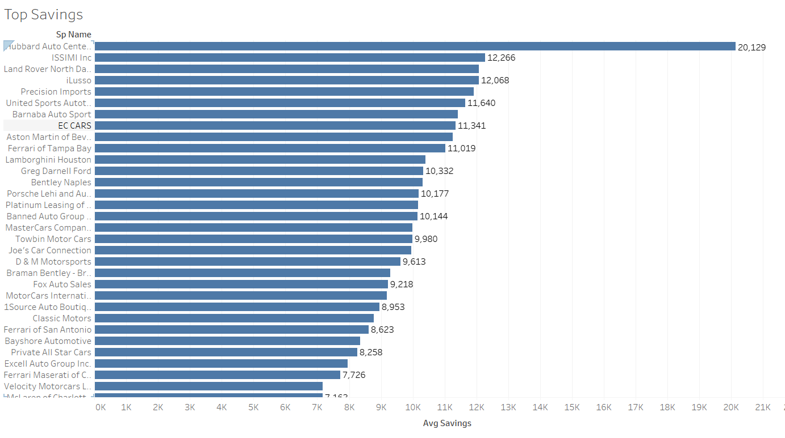
Average Savings Per Seller (Top)
Key Findings:
Hubbard Auto Center of Scottdale – $20,129
Total Average Savings - $3302.02
More Disparities Between Savings

Slide 22
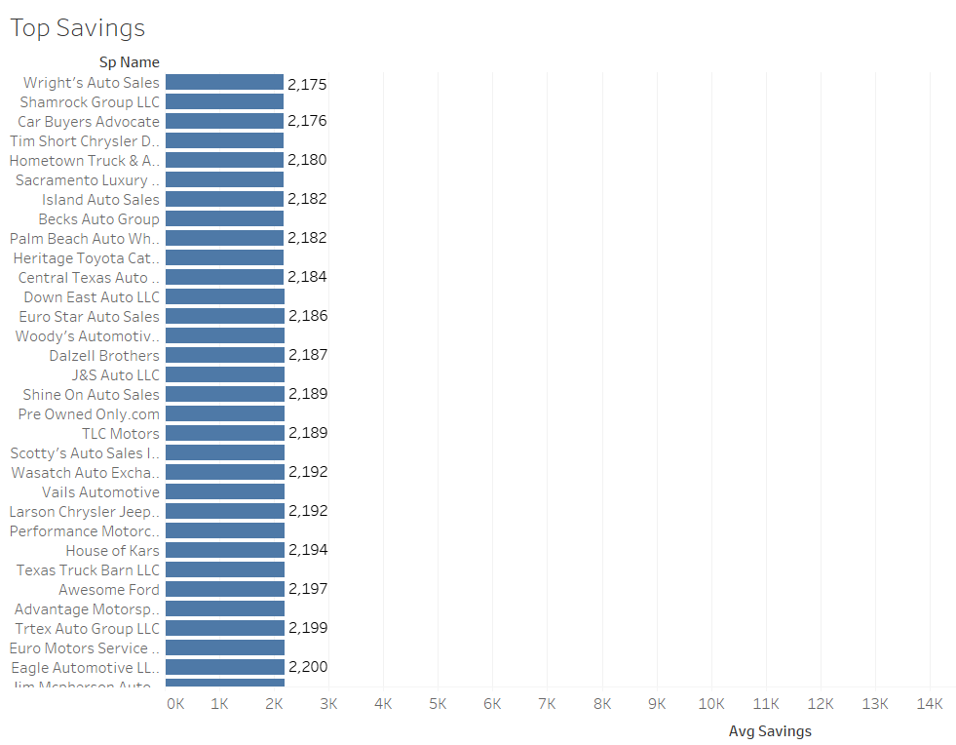
Average SAVINGS PER SELLER (Low)
Key Findings:
Wright’s Auto Sales – $2,175
Less Disparities Between Savings
Median - $2773
Mode - $2264

